Slide 1
Programming for Internet of Things
Object tracking and IoT Grocery Sync
Alyana Nelson
Ramprakash Sridharan

Slide 2
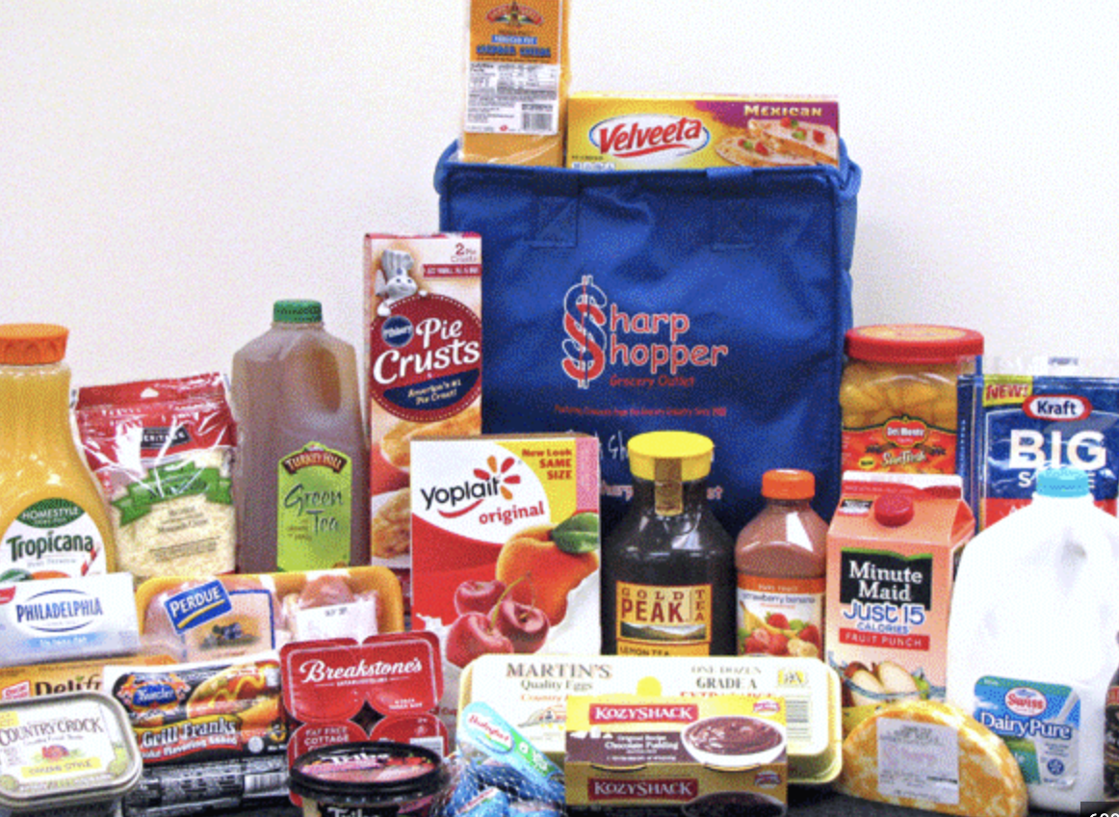
Task/Problem
A kitchen-based system that allows you to effortlessly add items to your grocery list.
Simply show the food product to the camera, and it will automatically update your 'grocery cart'. such as an Apples, water, yogurt, cereal, oil, etc.

Slide 3
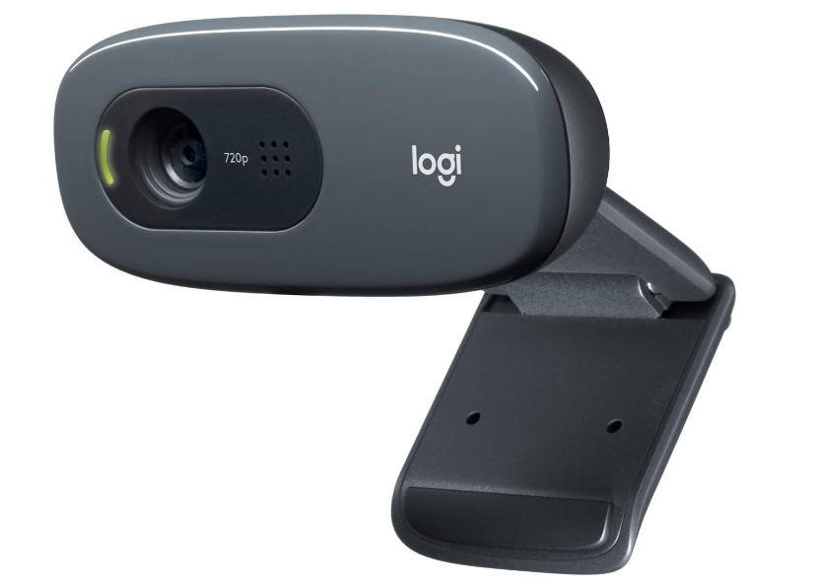
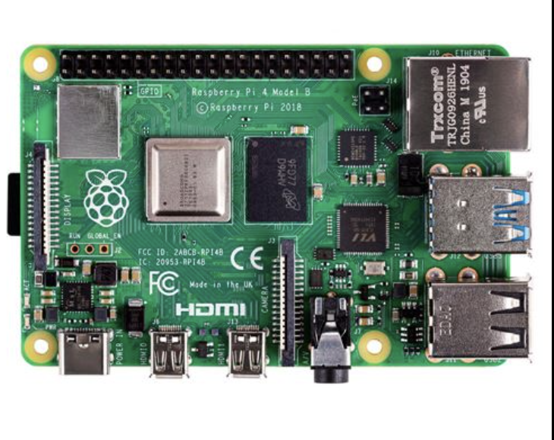
Components of the system
Hardware Components:
Rasberry Pi
Webcam
Software Components:
Yolov5 - Deep learning model for object tracking and classification.
Node server.
Webpage to track the grocery list .
Api to show product reviews and stocks.

Slide 4
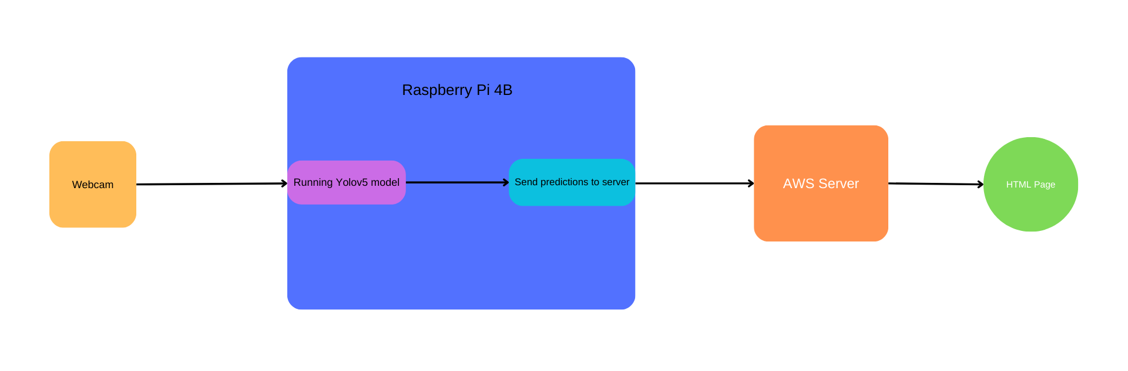
Interactions

Slide 5
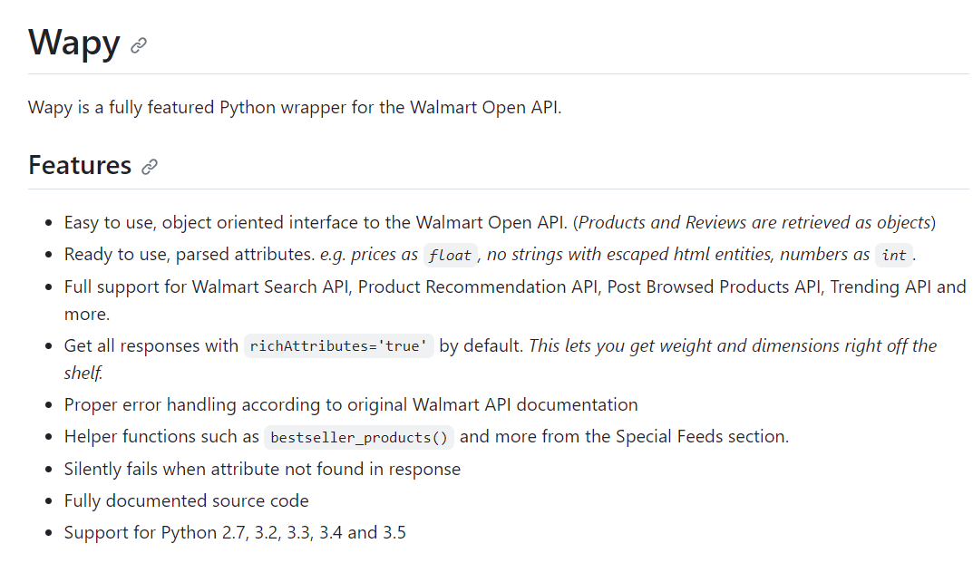
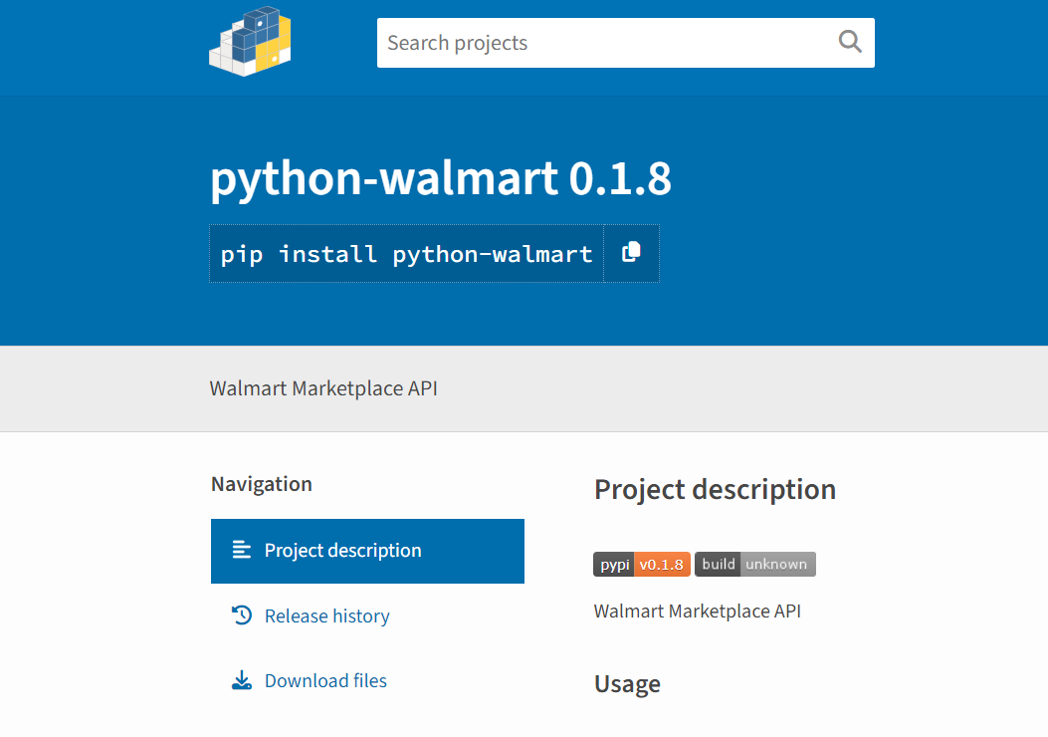
Tradeoffs
Can detect only a predefined set of objects that are trained into the Deep learning model.
Walmart does not offer an api to add stuff to the shopping cart .
However there are python api available to scrape the product data like reviews, stocks etc which can be displayed on the webpage.

Slide 6
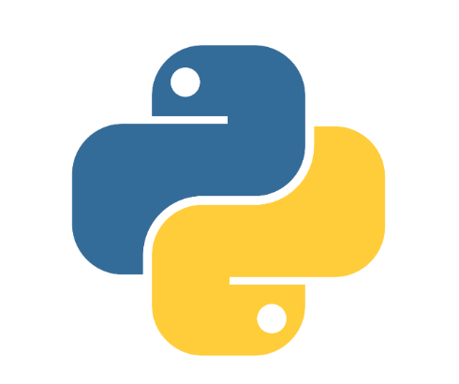



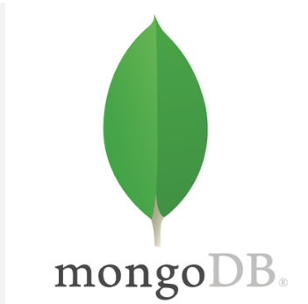
Tech stack
Python
Pytorch
Node js
Javascript, HTML, CSS
API - (WApy or Python-Walmart)
MongoDB

Slide 7
Challenges
Optimizing the Deep learning model.
Avoid accidental detection of the object.
Finding the right product from a list of similar products with some criteria.

Slide 8
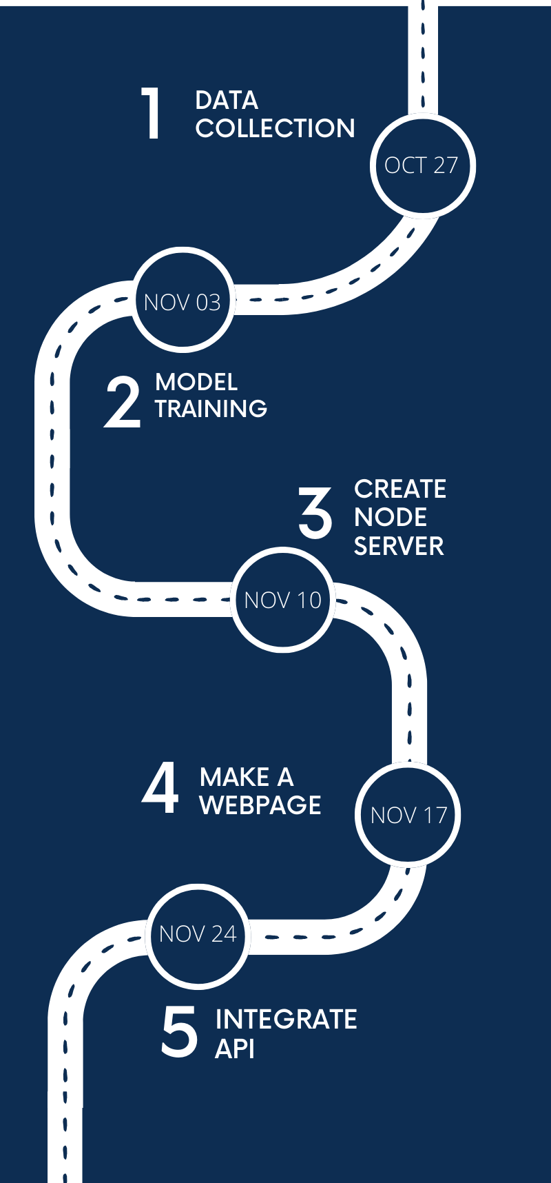
Timeline

